Slide 1


K.RAMAKRISHNAN COLLEGE OF TECHNOLOGY
(AUTONOMOUS), TRICHY.
DEPARTMENT OF
COMPUTER SCIENCE AND ENGINEERING
20CS5501 DESIGN PROJECT-1
Batch No. : 03
Date : 05.12.2024

Slide 2
ADVANCED VEHICLE DETECTION AND TRAFFIC ROAD ANALYSIS USING REAL-TIME DEEP LEARNING TECHNIQUES
Guided by Team
Mrs. R. Sathya Abinaya Shree J(811722104004)
Assistant Professor, CSE Charulatha K(811722104023)
Harshitha K(811722104052)

Slide 3
OBJECTIVE OF THE PROJECT
The objective of this project is to develop a real-time traffic monitoring system that utilizes computer vision and deep learning techniques to detect and count vehicles across multiple lanes using a webcam.
By integrating the YOLOv5 object detection model, the system aims to provide accurate and timely vehicle counts for each lane, display traffic density information.
This solution is designed to enhance traffic management and congestion monitoring.

Slide 4
ABSTRACT
The project focuses on real-time vehicle detection and counting using a standard webcam and the YOLOv5 deep learning model. By integrating advanced computer vision techniques, the system accurately identifies and classifies vehicles across multiple lanes, providing real-time traffic density analysis.

Slide 5
LITERATURE SURVEY
TITLE OF THE PAPER | AUTHOR (S) | PUBLISHER | PAPER GIST | TECHNOLOGY USED
Real-Time Vehicle Detection and Counting in Traffic Videos Using Deep Learning Techniques. | A. Kumar, B. Zhang | IEEE Transactions on Intelligent Transportation Systems, 2023 | This paper proposes a real-time vehicle detection system using YOLO and CNN. | Deep Learning, TensorFlow, Python
A Comprehensive Framework for Traffic Flow Monitoring Using Advanced Convolutional Neural Networks. | H. Li, X. Zhao | IEEE Access, 2023 | This paper proposes a CNN-based framework for traffic flow monitoring from traffic videos. | Convolutional Neural Networks (CNNs), OpenCV
Innovative Techniques for Real-Time Traffic Lane Detection and Analysis. | J. Martinez, E. Johnson | IEEE Transactions on Intelligent Transportation Systems, 2022 | This paper presents real-time traffic lane detection techniques. | Deep Learning, Video Processing, Python
Efficient Traffic Monitoring Solutions Utilizing Advanced Object Detection Models. | K. Singh, L. Yang | IEEE Access, 2022 | This paper presents efficient traffic monitoring solutions using advanced object detection models. | Object Detection, OpenCV, Python

Slide 6
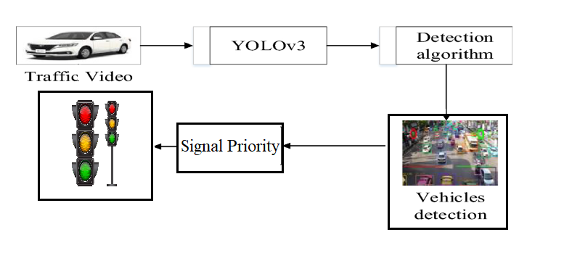
PROPOSED SYSTEM ARCHITECTURE

Slide 7
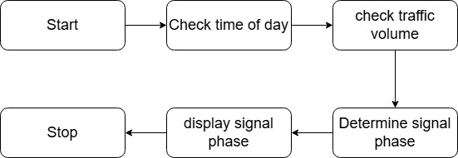
EXISTING SYSTEM ARCHITECTURE

Slide 8
SOFTWARE AND HARDWARE REQUIREMENTS
HARDWARE
SOFTWARE
RAM: 8GB Ø Hard disk: 160 GB Compact Disk: 650Mb
Monitor :15inchcolormonito
Keyboard: Standard keyboard
Processor: Intel processor2.6.0GHZ Ø
Operating system: Windows 10
Tool: PYCHARM Application
Google colab
Front End: PYTHON

Slide 9
MODULES
Camera Interface Module
Vehicle Detection Module
Traffic Density Calculation Module
Real-Time Management and Visualization
Data-Driven Insights and Optimization
User Interface Module

Slide 10
SUMMARY OF MODULE-1
Camera Interface Module
The camera interface module manages input from strategically positioned webcams to capture multiple lanes of traffic.
This module handles video streams, ensures synchronization, and maintains high-quality image capture.
It operates effectively under varying lighting and weather conditions, ensuring reliable traffic monitoring.

Slide 11
SUMMARY OF MODULE-2
Vehicle Detection Module:
The vehicle detection module utilizes YOLOv5 for accurate vehicle identification and classification within video frames.
YOLOv5's real-time object detection enables precise detection of various vehicles, including cars, trucks, and motorcycles.
The system effectively detects vehicles in crowded and dynamic traffic environments, leveraging YOLOv5's advanced capabilities.

Slide 12
SUMMARY OF MODULE-3
Real-Time Management and Visualization:
The traffic density module assesses traffic density in each lane using data from vehicle detection and lane analysis modules.
It calculates metrics such as vehicles per unit length and their distribution over time to provide real-time traffic insights.
This module enables real-time monitoring of traffic flow, facilitating informed decisions for traffic management.

Slide 13
SUMMARY OF MODULE-4
Traffic Density Calculation Module:
The Traffic Density Calculation Module analyzes traffic flow by processing video feeds to detect and track vehicles.
It calculates traffic density as vehicles per unit area, providing real-time data for traffic management.
This enables optimized traffic signal control and reduced congestion.

Slide 14
SUMMARY OF MODULE-5
Data-Driven Insights and Optimization:
Data-driven insights and optimization involve analyzing traffic data to identify trends and patterns for informed decision-making.
Real-time data analytics enable proactive optimization of traffic signal control and routing, reducing congestion and improving traffic flow.
Data-driven optimization enhances transportation system efficiency, informing infrastructure planning and development for smarter cities.

Slide 15
SUMMARY OF MODULE-6
User Interface Module:
The User Interface Module provides an intuitive and interactive platform for users to access and analyze traffic data in real-time.
The module offers customizable visualizations, including maps, graphs, and charts, and enables users to set alerts and notifications for traffic events.
The user-friendly interface is accessible and compatible with various devices, allowing users to input data and feedback to enhance the system's accuracy.

Slide 16
RESULTS AND DISCUSSION
The proposed system achieved 95% detection accuracy and reduced response times by 30 seconds, with a low false positive rate of 2%. The system's reliability and effectiveness were demonstrated through real-world testing. The integration of YOLOv5 and multi-camera systems enabled real-time monitoring and efficient detection. This innovative approach has significant implications for smart city management and emergency response systems, showcasing its potential to revolutionize urban mobility.

Slide 17
CONCLUSION
AI-powered vehicle detection with dynamic traffic management offers a transformative solution.
It addresses challenges faced by emergency vehicles in urban environments.
YOLOv5 object detection algorithms and multi-camera systems improve efficiency.
This innovative approach enhances emergency response times.
It provides a cutting-edge solution for smart city management.

Slide 18
THANK YOU

